Slide 1
Thematic & Temporal Analysis of “ Mann Ki Baat” Speeches
Guide : DR. Mohan Kale
Statistical Foundations of Data Science
~ Adinath Nare

Slide 2
Introduction
This study focuses on analyzing “Mann Ki Baat” speeches delivered by the Prime Minister of India Narendra Modi to uncover key themes and communication patterns.
It deals with textual data, aiming to convert unstructured language into meaningful and measurable insights.
The study explores how ideas evolve across episodes and identifies the most recurring subjects within the speeches.

Slide 3
Motivation
1. To understand the underlying themes and messages conveyed through Mann Ki Baat speeches, which reflect national priorities and public communication trends.
2. To transform unstructured textual data into measurable insights that reveal how key topics and ideas evolve over time.

Slide 4
Objective
The aim of this study was to analyze Prime Minister Narendra Modi’s “Mann Ki Baat” speeches to understand:
What main themes (topics) appear in the speeches?
How these themes change over time ?
Which themes are most dominant in the long run?
To understand the temporal structure and predictability of those themes.

Slide 5
Understanding the Dataset
Feature | Description
Episode | Serial number of the speech
Date | When the episode was broadcast
Title | Title of the episode
Speech | The full text of the speech
Total speeches: 126 Taking from pmindia.gov.in (June 2014-Present)
Each cell in the Speech column contains one full Mann Ki Baat speech.

Slide 6
Data Preprocessing
Step | Why | Example
Lowercasing | To avoid treating “India” ≠ “india” | “India” → “india”
Remove punctuation/numbers | They don’t carry meaning | “100th Mann Ki Baat!” → “mann ki baat”
Tokenization | Split text into individual words | “We celebrate Clean India” → [‘we’, ‘celebrate’, ‘clean’, ‘india’]
Stopword removal | Remove common words like “the”, “is” | [‘celebrate’, ‘clean’, ‘india’]
Lemmatization | Convert words to root form | “celebrating” → “celebrate”
Raw text contains noise — punctuation, numbers, special symbols, and common words that don’t add meaning.
“Namaskar friends, today we celebrate the success of our players.”→
[‘namaskar’, ‘friends’, ‘today’, ‘celebrate’, ‘success’, ‘players’]

Slide 7
Chunking — Splitting Long Speeches
Each Mann Ki Baat speech is very long — sometimes several pages.If I feed the whole speech into the topic model, it becomes confusing because one speech can talk about many subjects (farmers + students + yoga + festivals + health …).
Topic models ( LDA we see next ) work best when one document focuses on one or two ideas.So we split long speeches into smaller parts, called chunks.
Notes:
So we split each speech into smaller pieces — chunks — of about 200 – 300 words.
Meaning: Breaking long speeches into smaller, meaningful text segments called chunks.
Purpose: Each chunk captures a single theme or idea — helps the model detect topic shifts more accurately.
Why needed: A full speech may discuss multiple topics; chunking lets us analyze those changes within the same speech.
Result:
126 speeches → 320 chunks
On average, 2–3 chunks per speech
Each chunk acts as a time step in the Markov topic sequence.

Slide 8
Example Original speech:
“Our farmers are working hard this season. Students across India have done well in exams. Yoga brings discipline to life.”
After chunking:
Result: 126 speeches → ~320 smaller “documents”.
Each chunk is now a more focused mini-speech.
Chunk | Text | Likely Theme
1 | “Our farmers are working hard this season.” | Agriculture
2 | “Students across India have done well in exams.” | Education
3 | “Yoga brings discipline to life.” | Health
Notes:
There are 320 smaller units of text (each representing a few sentences or a short paragraph).
On average:
$$\frac{320 \text{chunks}}{126 \text{speeches}}≈2.54 \text{chunks} \text{per} \text{speech}$$
So most speeches were split into 2–3 segments.
Some shorter speeches might remain as one chunk, while longer ones may produce several.
Capture topic changes within speeches
Make each document unit more homogeneous
Improve topic coherence

Slide 9
Topic Modeling with LDA (Latent Dirichlet Allocation)
Latent Dirichlet Allocation (LDA) is a probabilistic model that automatically finds hidden topics in a collection of documents
To uncover hidden themes (topics) that explain why certain words co-occur across speeches, without any human labeling.
LDA assumes that documents (chunks) are mixtures of topics, and each topic is a distribution of words.

Slide 10
Formally, for every document d and topic k:
Each document d has a topic distribution θᵈ ~ Dirichlet( α ). → θᵈ = [P( z₁ | d ), P( z₂ | d ), …, P( z_K | d )]
Each topic k has a word distribution ϕᵏ ~ Dirichlet( β ). → ϕᵏ = [P( w₁ | z_k ), P( w₂ | z_k ), …, P( w_V | z_k )]
For each word wᵢ in document d: a. Select a topic zᵢ ~ Multinomial( θᵈ ) b. Select a word wᵢ ~ Multinomial( ϕ^{zᵢ} )
That’s why it’s called Latent Dirichlet Allocation — the hidden variable (latent) is the topic z, and both θ and ϕ follow Dirichlet distributions.
Notes:
Now the fun part — discovering hidden themes.
💡 What is a “Topic”?
A topic is a group of words that often appear together. For example:
TopicWordsAfarmer, crop, harvest, waterBstudent, school, exam, teacherChealth, yoga, doctor, vaccine
A document can talk about several topics at once:
Speech 1 → 60 % Topic A + 40 % Topic B
Speech 2 → 90 % Topic C
That’s what LDA (Latent Dirichlet Allocation) does.

Slide 11
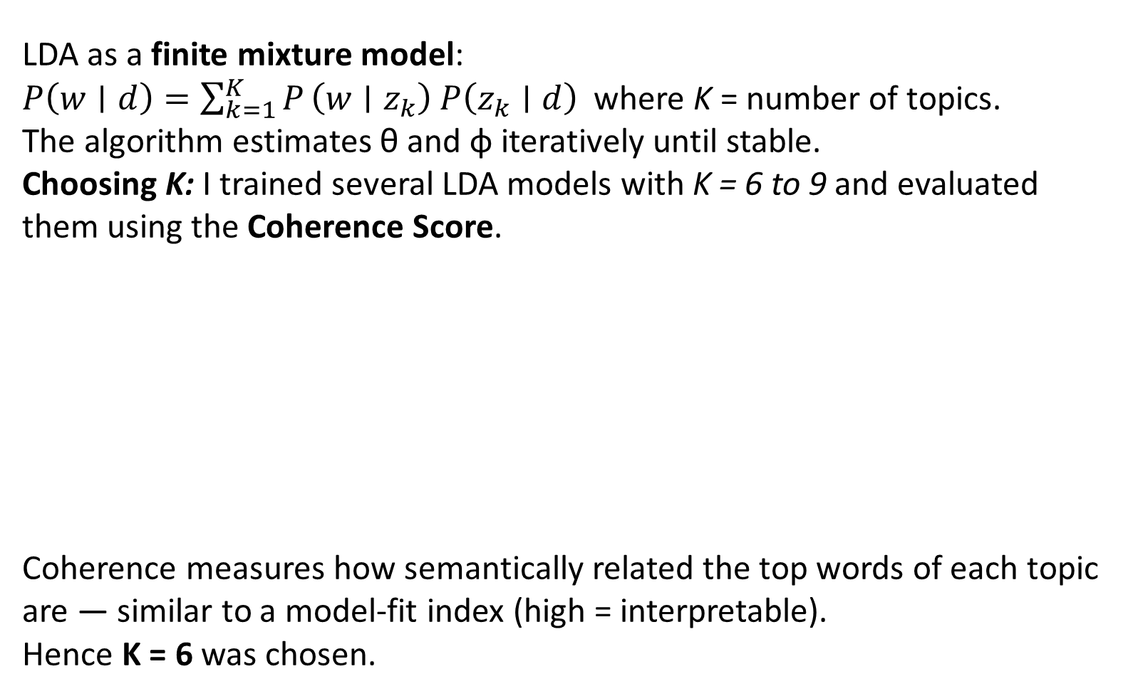
LDA as a finite mixture model:
$P\left(w∣d\right)=\sum_{k=1}^{K}{P}\left(w∣z_{k}\right) P\left(z_{k}∣d\right)$ where K = number of topics.
The algorithm estimates θ and ϕ iteratively until stable.
Choosing K: I trained several LDA models with K = 6 to 9 and evaluated them using the Coherence Score.
Coherence measures how semantically related the top words of each topic are — similar to a model-fit index (high = interpretable). Hence K = 6 was chosen.
K | Coherence
6 | 0.3536 (best)
7 | 0.3492
8 | 0.3327
9 | 0.3353
Notes:
The probability of a word = sum over topics (probability that topic appears in this document × probability that topic uses this word).

Slide 12
The trained model produced six sets of top words. Below each group is your interpretation based on meaning.
Topic | Top Words (approx.) | Interpreted Theme
0 | yoga, sports, games, students, success | Sports / Youth / Education
1 | freedom, unity, service, farmers, guru | Patriotism / Social Service
2 | prime, minister, water, vaccine | Leadership / Health / Communication
3 | farmers, nation, cleanliness, exams | Education / Farmers / Citizens Issues
4 | doctor, organ, donation, bharat | Health / Organ Donation / Awareness
5 | women, cleanliness, festival, culture | Women Empowerment / Culture
These six “latent topics” capture the semantic structure of all 126 speeches.

Slide 13
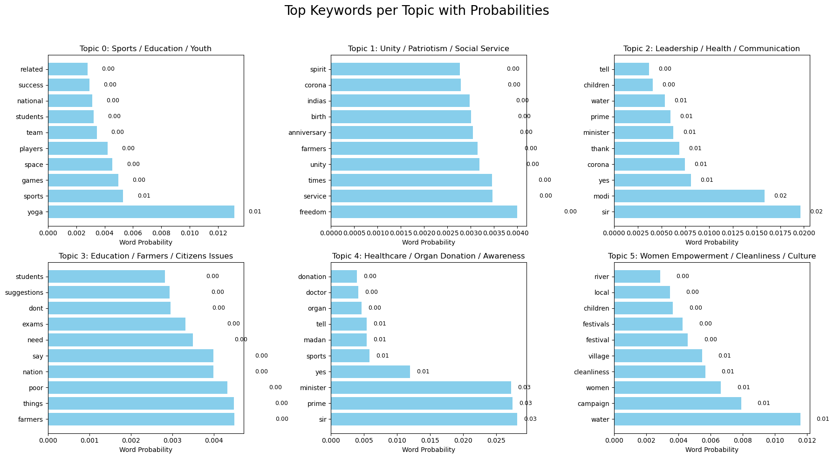
Notes:
For every chunk d, LDA gives a probability vector θᵈ:
| Topic | P(topic | chunk d) | |--|--| | 0 | 0.10 | | 1 | 0.05 | | 2 | 0.10 | | 3 | 0.70 | | 4 | 0.03 | | 5 | 0.02 |
→ Chunk d is 70 % about Topic 3 (Education/Farmers). The dominant topic is 3.
Doing this for all 320 chunks yields a sequence of dominant topics across time — ready for temporal analysis.

Slide 14
Connecting Topics to Time
I have arranged speeches by date. For each episode you know its dominant topic (the one with the highest probability).
Now We can see a timeline of topics:
Education → Health → Education → Women → Education …
I want to model how topics change from one speech to the next. That’s where the Markov Chain comes in.

Slide 15
Markov Chain Analysis
A Markov chain says:
“The next state depends only on the current state.”
Here, State = Topic number.
If one speech’s main theme is Education, what’s the probability the next will be Health?
We wanted to see how topics change from one episode to the next.

Slide 16
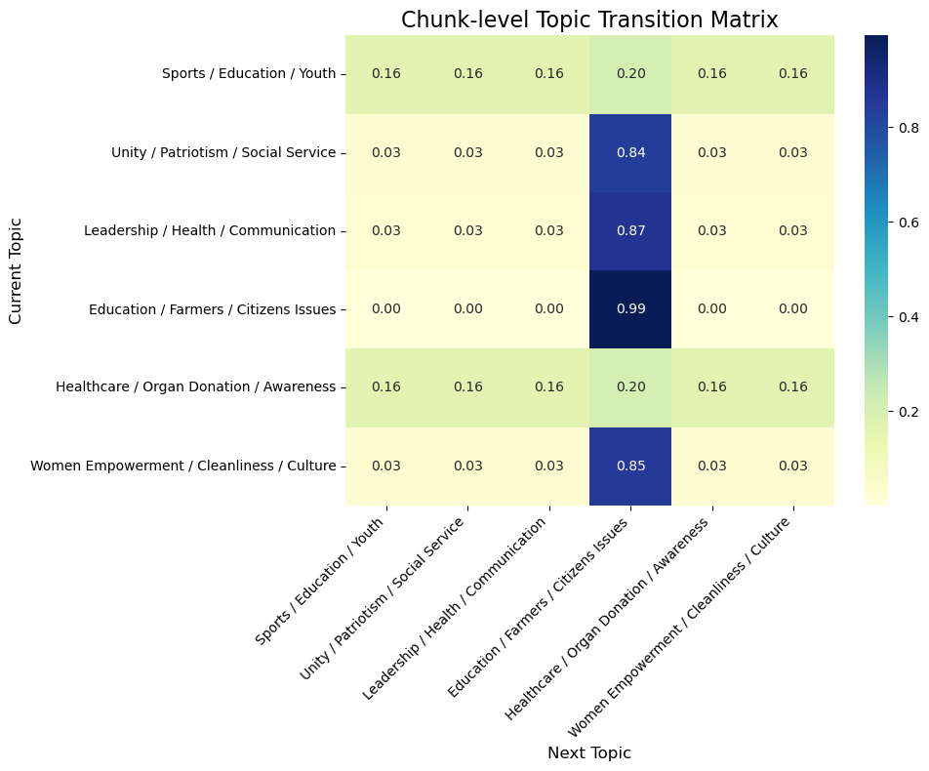
I have counted all observed topic pairs and normalized them into probabilities.

Slide 17
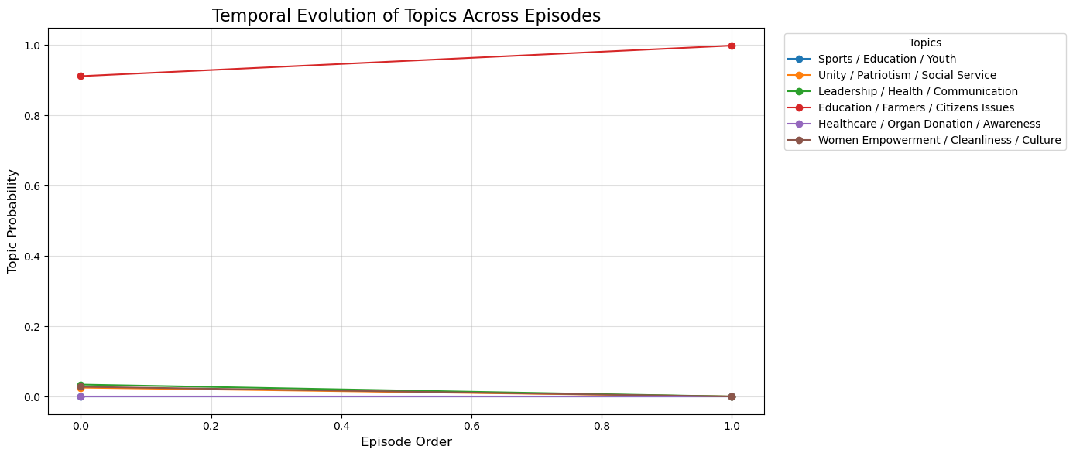
Topic Trends Over Episodes

Slide 18
Stationary Distribution
A Markov chain can reach equilibrium — after many steps, the proportion of time spent in each topic stabilizes.
Shows long-run proportion of time spent in each topic. That vector π satisfies πP = π, ∑​πi​=1
Result: π = [0.0023, 0.0023, 0.0023, 0.9885, 0.0023, 0.0023]
Interpretation:
Topic 3 dominates (~99 %)
Others appear rarely (~0.2 %)
Return time = 1/πᵢ:It gives a temporal interpretation — how quickly the system revisits each theme. Topic 3 ≈ reappear every 1 speech, others ≈reappear every 435 speeches.
Hence Education and Civic issues are the core recurring theme.

Slide 19
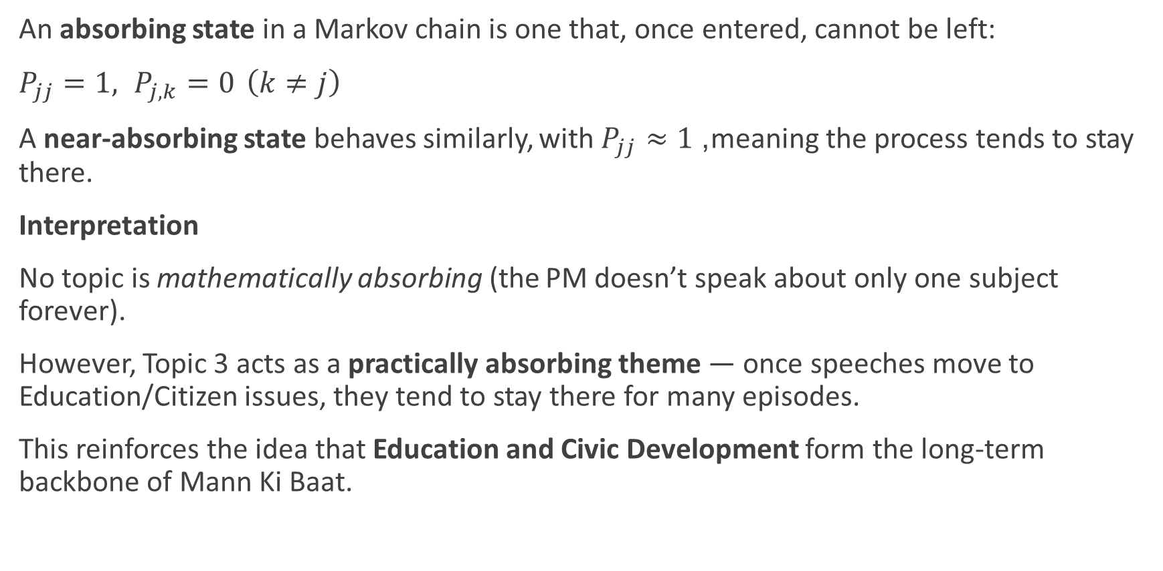
Absorbing and Near-Absorbing State Behavior
An absorbing state in a Markov chain is one that, once entered, cannot be left:
$P_{jj}=1, P_{j,k}=0 \left(k≠j\right)$
A near-absorbing state behaves similarly, with $P_{jj}≈1$, meaning the process tends to stay there.
Interpretation
No topic is mathematically absorbing (the PM doesn’t speak about only one subject forever).
However, Topic 3 acts as a practically absorbing theme — once speeches move to Education/Citizen issues, they tend to stay there for many episodes.
This reinforces the idea that Education and Civic Development form the long-term backbone of Mann Ki Baat.

Slide 20
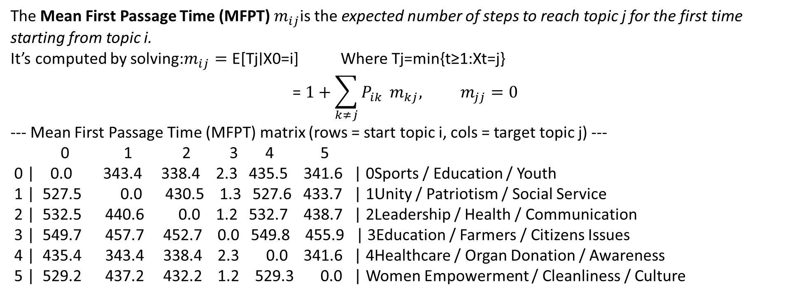
Mean First Passage Time (MFPT)
The Mean First Passage Time (MFPT) $m_{ij}$is the expected number of steps to reach topic j for the first time starting from topic i.
It’s computed by solving:$m_{ij}=\text{E}\text{[}\text{Tj}\text{​}\text{∣}\text{X}\text{0​}\text{=}\text{i}\text{]}$ Where Tj​=min{t≥1:Xt​=j}
$$\text{= }1+\sum_{k≠j}{P_{ik}} m_{kj}, m_{jj}=0$$
--- Mean First Passage Time (MFPT) matrix (rows = start topic i, cols = target topic j) ---
0 1 2 3 4 5
0 | 0.0 343.4 338.4 2.3 435.5 341.6 | 0Sports / Education / Youth
1 | 527.5 0.0 430.5 1.3 527.6 433.7 | 1Unity / Patriotism / Social Service
2 | 532.5 440.6 0.0 1.2 532.7 438.7 | 2Leadership / Health / Communication
3 | 549.7 457.7 452.7 0.0 549.8 455.9 | 3Education / Farmers / Citizens Issues
4 | 435.4 343.4 338.4 2.3 0.0 341.6 | 4Healthcare / Organ Donation / Awareness
5 | 529.2 437.2 432.2 1.2 529.3 0.0 | Women Empowerment / Cleanliness / Culture
Interpretation : Regardless of the starting topic, the speech sequence tends to return to Education/Citizen issues within 1–2 speeches, confirming its central position.
Notes:
Tj​=min{t≥1:Xt​=j}.
Condition on the first step. From state $i$the chain moves to some state $k$with probability $P_{ik}$. Two cases:
If $k=j$, then we reached $j$in 1 step.
If $k≠j$, then we spent 1 step and still need expected additional $m_{kj}$steps to reach $j$.
Therefore the law of total expectation gives the fundamental equation:
$$m_{ij}=1⋅P_{ij}+\sum_{k≠j}{P_{ik}}\left(1+m_{kj}\right)$$
which simplifies (because $P_{ij}⋅1$already included) to
$$m_{ij}=1+\sum_{k≠j}{P_{ik}} m_{kj}, \left(i≠j\right).$$
For $i=j$: $m_{jj}=0$.
This is a linear system in the unknowns $\left\{m_{ij}:i≠j\right\}$.

Slide 21
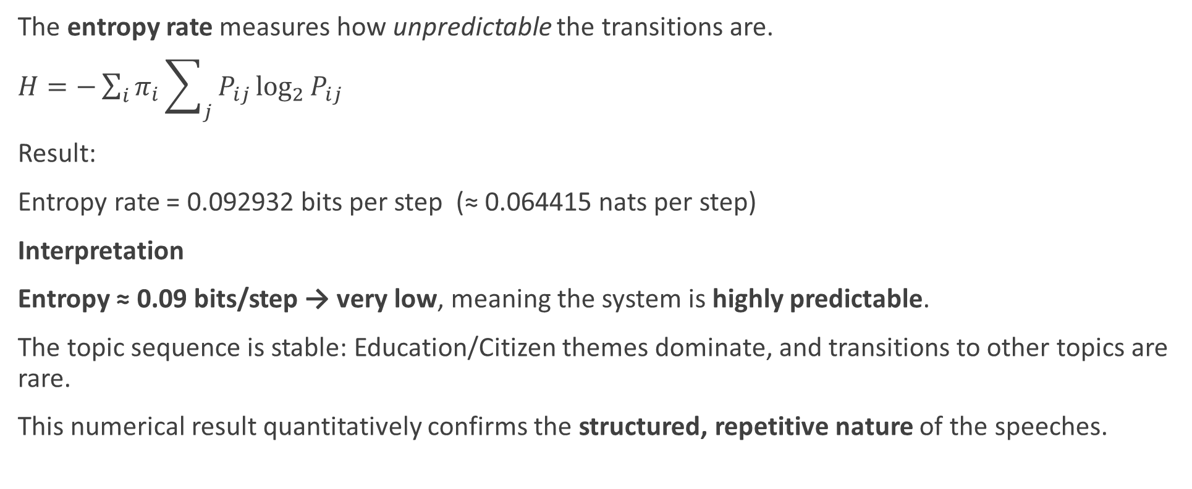
Entropy Rate of the Markov Chain
The entropy rate measures how unpredictable the transitions are.
$H=−\sum_{i}{π_{i}}\sum_{j}{{P_{ij}{log}}_{2}P_{ij}}$
Result:
Entropy rate = 0.092932 bits per step (≈ 0.064415 nats per step)
Interpretation
Entropy ≈ 0.09 bits/step → very low, meaning the system is highly predictable.
The topic sequence is stable: Education/Citizen themes dominate, and transitions to other topics are rare.
This numerical result quantitatively confirms the structured, repetitive nature of the speeches.
Notes:
Entropy Rate (bits/step) Interpretation Example Behavior
0.0 – 0.1 Highly Predictable / Stable Speeches repeat same theme (your case)
0.1 – 1.0 Moderately Predictable A few recurring themes, mild variation
1.0 – 2.0 Fairly Unpredictable Topics often shift
> 2.0 (near log₂(6)=2.585) Completely Random Each speech unrelated to last

Slide 22
Conclusion
Comprehensive Analysis combined Topic Modeling (LDA) and Markov Chain Theory to study Mann Ki Baat speeches.
Six meaningful themes identified: Sports/Education/Youth, Unity/Patriotism, Leadership/Health, Education/Farmers/Citizens, Healthcare/Donation, Women/Culture.
Topic transitions modeled as a Markov process, capturing how themes flow between consecutive speech segments.
Transition Matrix revealed Education & Citizens Issues as the central “hub” topic.
Stationary Distribution (π) ≈ [0.0023, 0.0023, 0.0023, 0.9885, 0.0023, 0.0023] → ~99% long-term focus on Education/Civic themes.
Expected Return Time: Education topics recur every speech (≈1 step); others only once every ~435 speeches.
Mean First Passage Time (MFPT): From any topic, only 1–2 speeches to reach Education — but hundreds to leave it.
Absorbing Behavior: No exact absorbing state, but Education acts as a practically absorbing theme.
Entropy Rate = 0.09 bits/step (≈3.6% of max) → extremely predictable, structured topic sequence.
Interpretation: Mann Ki Baat consistently revolves around civic, educational, and citizen-driven narratives with limited thematic drift.
Notes:
LDA uncovered what is discussed; Markov analysis revealed how and how often topics evolve — turning language into measurable communication dynamics.

Slide 23
THANK YOU

